Slide 1
Works
1
Research flowchart
a. WSI image preprocessing
d. Biomarker prediction model
- attention-based model (attMIL)
- patch generation
- transformer-based model (transMIL)
- color normalization (Macenko method)
- blurry patch removal (Laplacian algorithm)
- graph neural network (GNN)
e. Model interpretability
b. Tumor detection model
- attention heatmap
- VGG19, ResNet101
- tissue type heatmap
- grad-cam
c. Feature extraction
- pretrained CNN model (ResNet50)
- self-supervised learning (SimCLR)

Slide 2
Works
2
New dataset for tumor classification model training (TCGA-HE-89K)
3
Independent cohort for final evaluation (CPTAC-COAD)

Slide 3
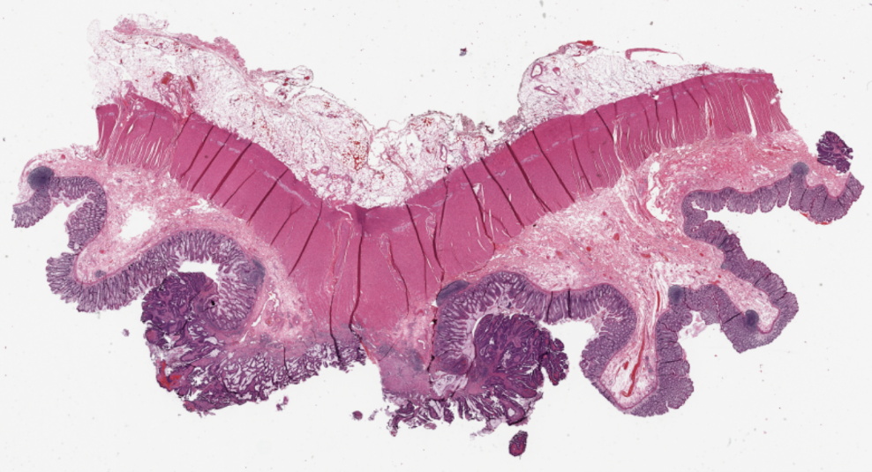
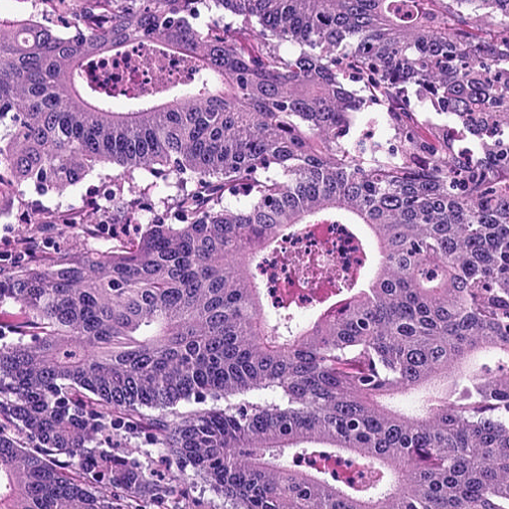
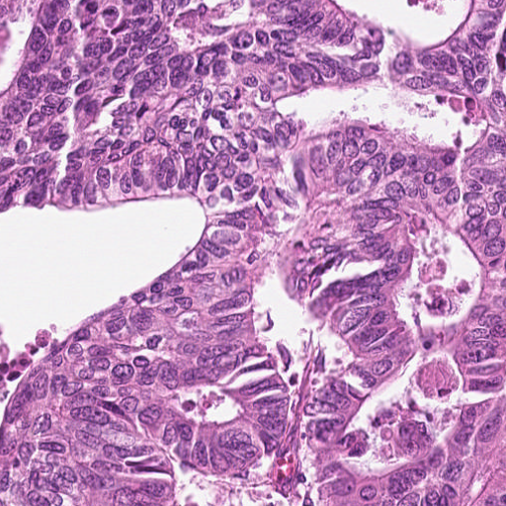
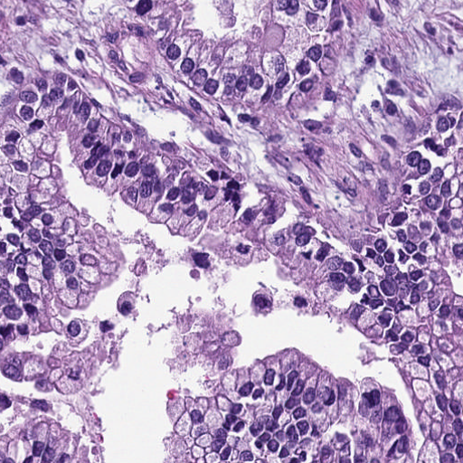
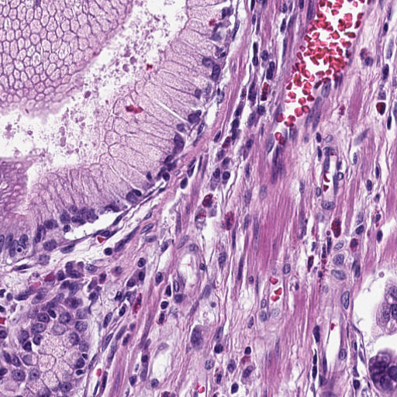
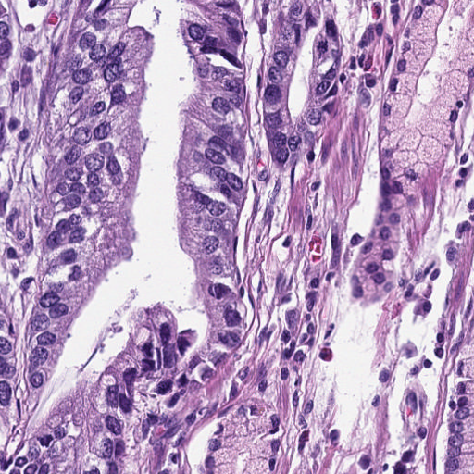
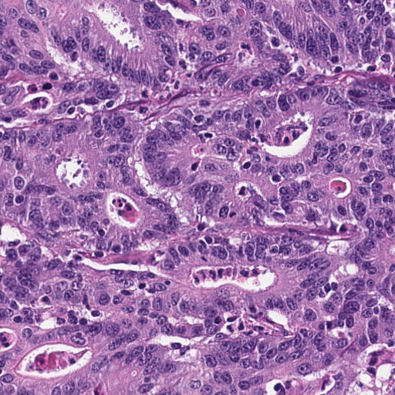
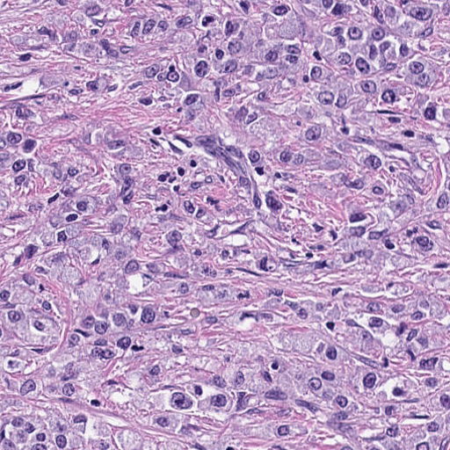
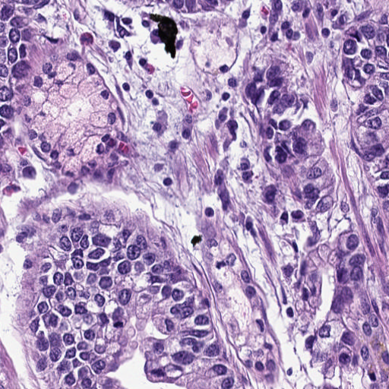
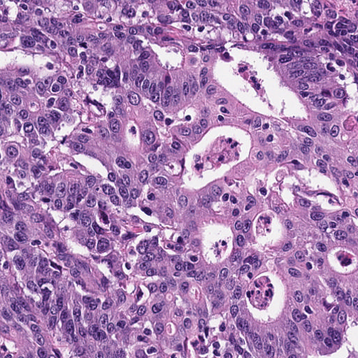
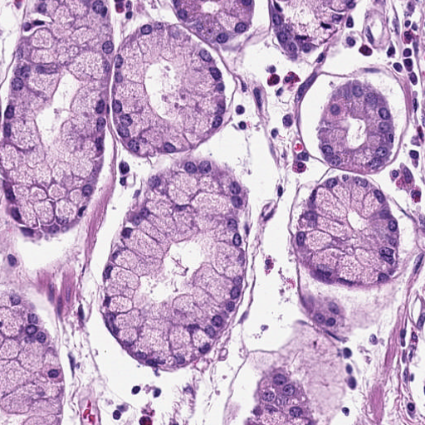
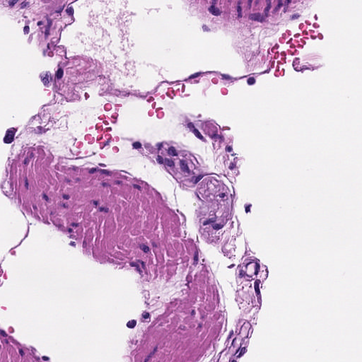
a. Image preprocessing
b. Tumor detection model
c. Feature extraction
TCGA WSIs with molecular label
NCT patches with tissue label
TCGA tumor patches
n
training dataset
testing dataset
Feature extractor
N
2048 dim
……
……
Classification model
n
……
TCGA patches without tissue type label
……

Slide 4
a. Image preprocessing
b. Tumor detection model
c. Feature extraction
TCGA WSIs with molecular label
NCT patches with tissue label
TCGA tumor patches
Cross cohort problem:
train on NCT but inference on TCGA
n
training dataset
testing dataset
We don’ t know whether the classified TCGA tumor patch is correct or not.
Feature extractor
N
2048 dim
……
……
Classification model
n
……
TCGA patches without tissue type label
……

Slide 5
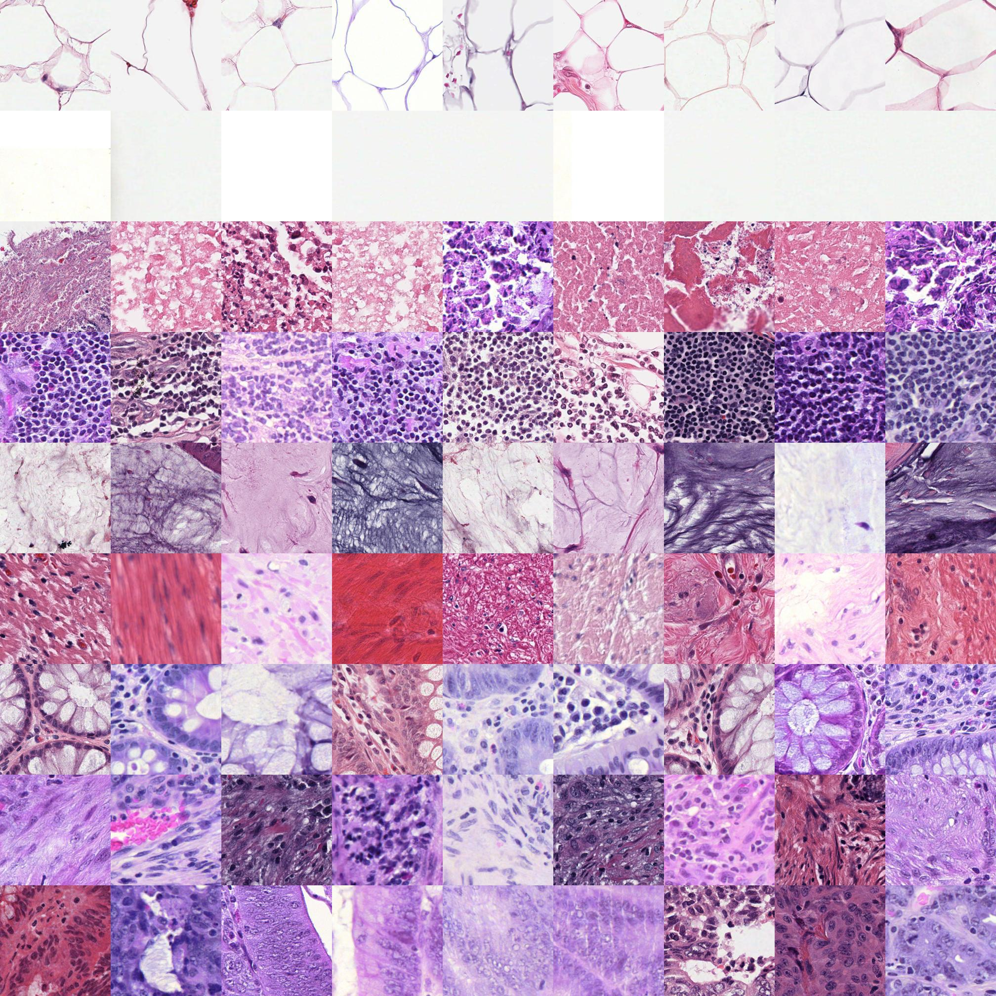
TCGA-HE-89K
ADI
TCGA-COAD (The Cancer Genome Atlas)
It contains 89100 histological image patches derived from 85 whole-slide images in 9 classes.
BACK
DEB
Tissue classes are:
Adipose (ADI)
Background (BACK)
Debris (DEB)
Lymphocytes (LYM)
Mucus (MUC)
Smooth muscle (MUS)
Normal colon mucosa (NORM)
Cancer-associated stroma (STR)
Colorectal adenocarcinoma epithelium (TUM)
LYM
MUC
MUS
NORM
STR
All images are 224 x 224 pixels at 0.5 microns per pixel (MPP) and represents a non-overlapping image.
TUM

Slide 6
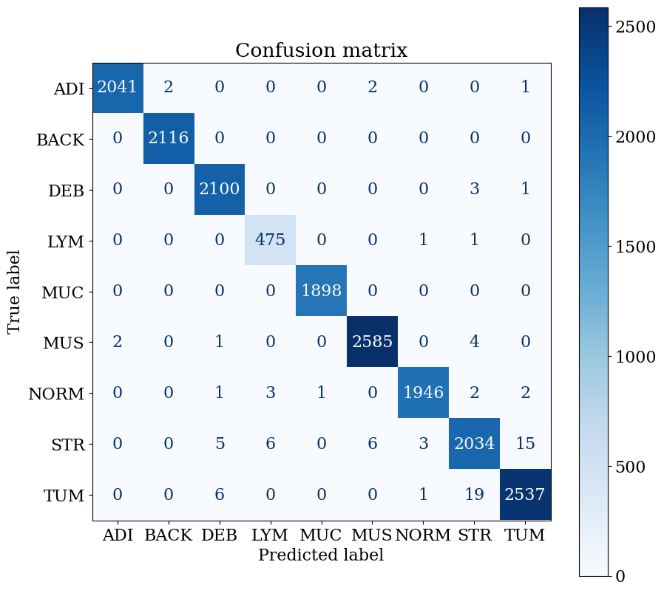

TCGA-HE-89K testing result
We use both VGG19 and ResNet101 to test TCGA-HE-89K.
testing | accuracy | precision of TUM | recall of TUM | cohen kappa | matthews
VGG19 | 0.995 | 0.993 | 0.990 | 0.994 | 0.994
ResNet101 | 0.996 | 0.994 | 0.992 | 0.996 | 0.996
VGG19
ResNet101

Slide 7
d. Biomarker prediction models
e. Model interpretability
n * 2048
1 * n
Attention module
……
……
1
……
Att-MIL
…
……
Fully-connected layer
KRAS, BRAF and MSI
(n + 1) * 512
n * 2048
KRAS, BRAF and MSI
CLS
……
……
Fully-connected layer
Ensemble
Transformer layer
2
……
Linear projection
……
Transformer layer
Trans-MIL
……
……
…
n * 2048
3
Graph neural network
KRAS, BRAF and MSI
…
Trans-MIL

Slide 8

CPTAC-COAD
This collection contains subjects from the National Cancer Institute’s Clinical Proteomic Tumor Analysis Consortium (CPTAC Colon Adenocarcinoma cohort).
The slides data can be downloaded from TCIA (The Cancer Imaging Archive).
We can utilize IBM-Aspera-Connect, which is a tool for large data download.
Detailed description
testing | statistics
participants | 106
WSIs | 373
data format | SVS
Genomic and clinical data are both available.

Slide 9
Future works
1
Keep producing additional research results

